Slide 1

NexLattice: Secure, Plug&play Offgrid Wi-Fi Mesh for IoT
A Project Presentation submitted in partial fulfilment of the requirements for the degree of
Bachelor of Technology in Computer Science and Engineering
By
Vivek Upadhaya
ROLL NO.: ADTU/2022-26/BCS/048
Debayangshu Sen
ROLL NO.: ADTU/2022-26/BCS/049
Rajdeep Roy
ROLL NO.: ADTU/2022-26/BCS/046
Under the guidance of
Dr. Debashis Dev Misra
Associate Professor
Dean I/C
FACULTY OF COMPUTER TECHNOLOGY
ASSAM DOWN TOWN UNIVERSITY
GUWAHATI-26, ASSAM.
December 2025
1

Slide 2
Quality Assessment & Morphometric Analysis System
Table of Contents
INTRODUCTION
PROBLEM STATEMENT
MOTIVATION
OBJECTIVES
LITERATURE REVIEW
METHODOLOGY
SYSTEM ARCHITECTURE
IMPLEMENTATION
CHALLENGES
CURRENT FINDINGS
REFERENCES
FACULTY OF COMPUTER TECHNOLOGY
ASSAM DOWN TOWN UNIVERSITY
2

Slide 3
Quality Assessment & Morphometric Analysis System
INTRODUCTION
NexLattice is a secure, plug-and-play Wi-Fi mesh network for IoT devices.
Unlike existing protocols, it uses standard Wi-Fi to create a self-healing, scalable, and offline network.
The protocol is designed to be universal and works on :
  ESP32
  Raspberry Pi Pico W
  Other similar microcontrollers.
FACULTY OF COMPUTER TECHNOLOGY
ASSAM DOWN TOWN UNIVERSITY
3

Slide 4
Quality Assessment & Morphometric Analysis System
PROBLEM STATEMENT
Issues : Current mesh networking protocols like Zigbee, LoRa, and ESP-MESH are often vendor-specific, low-speed, or require special hardware.
Gap : There’s a gap in universal, secure Wi-Fi mesh networking that can be used across different IoT devices, without needing a router or internet.
FACULTY OF COMPUTER TECHNOLOGY
ASSAM DOWN TOWN UNIVERSITY
4

Slide 5
Quality Assessment & Morphometric Analysis System
MOTIVATION
Universal Compatibility: Existing mesh protocols (e.g., Zigbee, LoRa) require specific hardware or are not Wi-Fi based. NexLattice aims to fill this gap by using standard Wi-Fi that works across various microcontrollers (ESP32, Raspberry Pi Pico, etc.).
Offgrid Communication: Wi-Fi mesh can operate without the need for routers or internet, making it perfect for offgrid environments like disaster zones, rural areas, or remote sensor networks.
Secure and Lightweight: Unlike many mesh protocols, NexLattice ensures secure data exchange (encryption) while keeping low latency and minimal power consumption.
Scalable and Fault-Tolerant: The system is self-healing and can scale to a large number of devices, ensuring reliable communication even when nodes fail or leave the network.
Plug-and-Play Setup: Easy integration for developers, with a simple MicroPython library for quick deployment, allowing anyone to create their own mesh network with minimal configuration.
FACULTY OF COMPUTER TECHNOLOGY
ASSAM DOWN TOWN UNIVERSITY
5

Slide 6
Quality Assessment & Morphometric Analysis System
OBJECTIVES
AIM :
To develop a universal, secure, and scalable Wi-Fi mesh protocol for IoT devices, enabling offline, peer-to-peer communication without reliance on routers or internet access.
Objectives :
Design and Develop a universal Wi-Fi mesh protocol.
Ensure secure, encrypted, and peer-to-peer communication.
Provide plug-and-play support for devices like ESP32.
Build a dashboard for monitoring and control.
FACULTY OF COMPUTER TECHNOLOGY
ASSAM DOWN TOWN UNIVERSITY
6

Slide 7
Quality Assessment & Morphometric Analysis System
LITERATURE REVIEW
Author(s) & Year | Title | Methodology | Research Purpose | Key Findings
J. M. Solé, R. P. Centelles, F. Freitag, R. Meseguer, R. Baig (2025) | Middleware for Distributed Applications in a LoRa Mesh Network | Middleware design, system architecture, experimental evaluation | To enable distributed applications over LoRa-based mesh networks | Middleware abstraction simplifies application development and enables scalable distributed coordination despite LoRa constraints
R. Berto, P. Napoletano, M. Savi (2021) | A LoRa-Based Mesh Network for Peer-to-Peer Long-Range Communication | Prototype implementation, field experiments | To investigate peer-to-peer long-range communication using LoRa mesh | LoRa mesh networking supports decentralized communication with extended coverage and acceptable reliability
N. L. Giménez et al. (2023) | Embedded Federated Learning over a LoRa Mesh Network | Embedded implementation, federated learning experiments | To assess feasibility of federated learning over LoRa mesh networks | Federated learning is feasible on constrained LoRa meshes with optimized communication strategies
Z. Sun et al. (2022) | Recent Advances in LoRa: A Comprehensive Survey | Systematic literature review | To review state-of-the-art LoRa technologies and applications | Identifies scalability challenges, mesh extensions, and open research problems in LoRa networks
W. Wang, G. He, J. Wan (2011) | Research on ZigBee Wireless Communication Technology | Protocol analysis, technical evaluation | To analyze ZigBee communication principles and performance | ZigBee offers low power consumption, self-organizing mesh networking, and reliability for short-range IoT
J. Bicket, D. Aguayo, S. Biswas, R. Morris (2005) | Architecture and Evaluation of an Unplanned 802.11b Mesh Network | Real-world deployment, performance measurement | To evaluate unplanned Wi-Fi mesh network architectures | Demonstrates robustness, self-configuration, and fault tolerance in real mesh deployments
Espressif Systems (2020) | ESP-MESH: Networking Solution Based on ESP32 | Technical documentation, system design description | To document ESP-MESH networking architecture | ESP-MESH provides scalable, self-healing Wi-Fi mesh networking for ESP32-based IoT systems
S. Sicari, A. Rizzardi, L. A. Grieco, A. Coen-Porisini (2015) | Security, Privacy and Trust in Internet of Things: The Road Ahead | Survey and conceptual analysis | To identify IoT security, privacy, and trust challenges | Highlights major vulnerabilities and calls for holistic, security-by-design IoT architectures
E. Fernandes, J. Jung, A. Prakash (2016) | Security Analysis of Emerging Smart Home Applications | Static and dynamic security analysis | To evaluate security of smart home applications | Reveals widespread security weaknesses and insufficient permission controls
C. M. Ramya, M. Shanmugaraj, R. Prabakaran (2011) | Study on ZigBee Technology | Comparative study, standards analysis | To study ZigBee standards and use cases | Confirms ZigBee’s effectiveness for low-data-rate, low-power wireless sensor networks
A. N. A. A. Aziz, R. A. Rashid, M. N. M. Nasir, M. A. Sarijari (2024) | ESP Mesh Network for Security Application | Prototype development, experimental evaluation | To evaluate ESP-MESH for security-related applications | ESP-MESH demonstrates reliable communication and low latency for distributed security systems
Table 1: Comparative Study of Related Works
FACULTY OF COMPUTER TECHNOLOGY
ASSAM DOWN TOWN UNIVERSITY
7

Slide 8
Quality Assessment & Morphometric Analysis System
LITERATURE REVIEW
Identified Research Gaps | Limitations in existing work | Our Proposed Solution
Limited support for true multi-hop, application-level LoRa mesh networking | Most LoRa solutions focus on star topology or basic routing without application abstraction | NexLattice introduces a modular mesh framework with application-aware routing and middleware support
High communication overhead in constrained LoRa mesh environments | Existing systems suffer from latency and packet loss under dense or multi-hop scenarios | NexLattice uses lightweight messaging, adaptive forwarding, and duty-cycle–aware scheduling
Poor integration of edge intelligence in low-power mesh networks | Federated learning and analytics are rarely optimized for extreme bandwidth limits | NexLattice enables optional edge intelligence with ultra-lightweight data aggregation and model updates
Limited security mechanisms in ESP/Wi-Fi mesh and LPWAN hybrids | Security is often add-on and not end-to-end across heterogeneous nodes | NexLattice embeds secure node authentication and encrypted mesh communication by design
Lack of unified framework across LoRa, ESP-MESH, and heterogeneous IoT nodes | Prior work targets single technologies in isolation | NexLattice provides a unified, extensible lattice-style architecture supporting heterogeneous mesh nodes
Table 2: Identified Research Gaps and Proposed solutions
FACULTY OF COMPUTER TECHNOLOGY
ASSAM DOWN TOWN UNIVERSITY
8

Slide 9
Quality Assessment & Morphometric Analysis System
METHODOLOGY
Protocol Design :
  Develop a lightweight Wi-Fi mesh protocol using UDP packets for low-latency communication and integrate AES encryption for secure data exchange.
Node Discovery & Network Formation :
  Implement discovery signals to allow devices to find each other and form a self-healing mesh network. Nodes forward messages to the destination via hop-based routing.
Security :
  Use AES-128 encryption and authentication to ensure secure, peer-to-peer communication. Each message will include a nonce and timestamp to prevent replay attacks.
Plug-and-Play Setup :
  Provide a MicroPython library for easy integration with IoT devices, enabling automatic setup of the mesh network without additional configurations.
Dashboard :
  Develop a web-based dashboard to visualize the mesh network, monitor node status, and track performance metrics like latency and packet delivery ratio.
FACULTY OF COMPUTER TECHNOLOGY
ASSAM DOWN TOWN UNIVERSITY
9

Slide 10
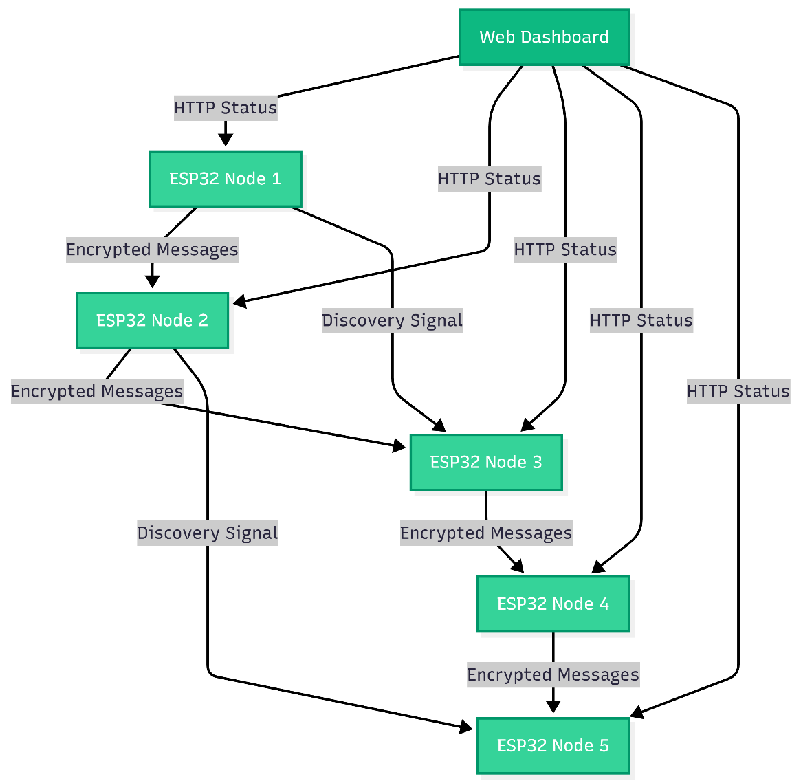
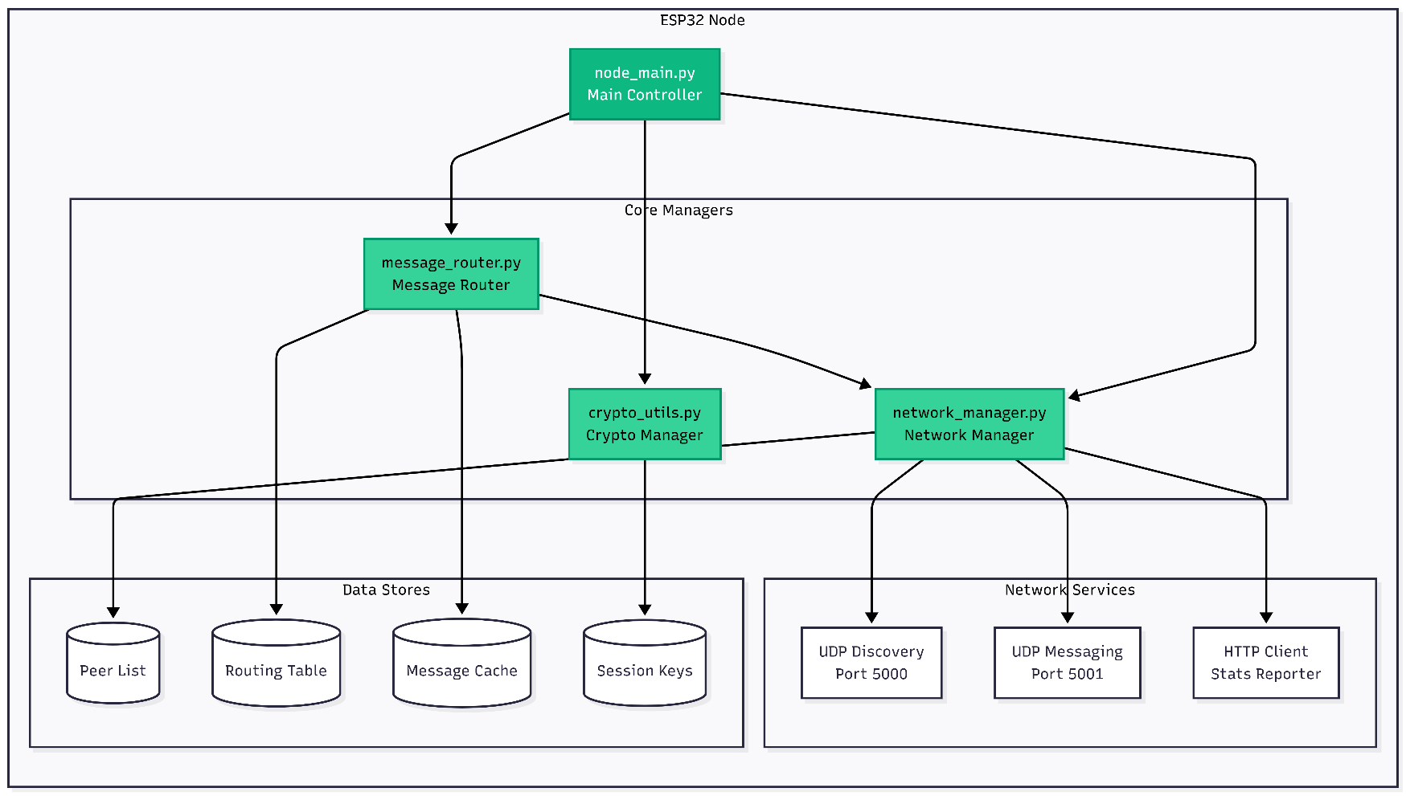
Quality Assessment & Morphometric Analysis System
SYSTEM ARCHITECTURE & NODE ARCHITECTURE
S EACH USER’O
FACULTY OF COMPUTER TECHNOLOGY
ASSAM DOWN TOWN UNIVERSITY
10

Slide 11
Quality Assessment & Morphometric Analysis System
IMPLEMENTATION
The NexLattice protocol enables Wi-Fi-based mesh networking for IoT devices, allowing them to communicate securely without the need for routers or internet.
Wi-Fi Mesh Protocol:
  Uses UDP for communication and AES-128 encryption for secure data transfer.
  Allows devices to form a self-healing mesh network.
Node Discovery:
  Nodes send discovery signals (UDP broadcast) to find nearby devices and form connections.
Routing:
  Hop-based routing forwards messages to the destination through intermediate nodes, using local routing tables.
Plug-and-Play Setup:
  Integrated via MicroPython, enabling easy plug-and-play setup for devices like ESP32.
Security:
  AES encryption and device authentication ensure secure and trusted communication.
Monitoring Dashboard:
  A web dashboard tracks node status, latency, and packet delivery.
FACULTY OF COMPUTER TECHNOLOGY
ASSAM DOWN TOWN UNIVERSITY
11

Slide 12
Quality Assessment & Morphometric Analysis System
CHALLENGES
Scalability:
  Challenge: Increased nodes could lead to congestion.
  Solution: Efficient hop-based routing and dynamic path recalculation.
Latency:
  Challenge: Maintaining low latency in a mesh network.
  Solution: Optimized UDP messaging with minimal overhead.
Network Instability:
  Challenge: Nodes joining/leaving the network.
  Solution: Self-healing network with automatic reconnection.
Energy Consumption:
  Challenge: Low power usage for battery-operated devices.
  Solution: Efficient routing and sleep modes for nodes when inactive.
Security:
  Challenge: Ensuring secure communication without performance loss.
  Solution: Lightweight AES encryption and node authentication.
Device Compatibility:
  Challenge: Supporting various IoT devices.
  Solution: MicroPython library for easy plug-and-play integration.
FACULTY OF COMPUTER TECHNOLOGY
ASSAM DOWN TOWN UNIVERSITY
15

Slide 13
Quality Assessment & Morphometric Analysis System
CURRENT FINDINGS
Novel Approach:
  NexLattice is a unique Wi-Fi mesh protocol that works across a wide range of IoT devices, providing secure, decentralized communication without relying on external infrastructure like routers.
No Existing Alternatives:
  Unlike existing protocols (e.g., Zigbee, LoRa, or ESP-MESH), which often depend on specialized hardware or require centralized management, NexLattice is based purely on Wi-Fi and operates without centralized control.
Self-Healing Network:
  The self-healing mesh network allows nodes to join or leave dynamically, offering scalability and flexibility that most other mesh networks lack.
Plug-and-Play Integration:
  The protocol’s integration into devices like ESP32 through MicroPython makes it easy to set up and use, something not commonly seen in existing mesh protocols.
FACULTY OF COMPUTER TECHNOLOGY
ASSAM DOWN TOWN UNIVERSITY
16

Slide 14
Quality Assessment & Morphometric Analysis System
REFERENCES
[1] J. M. Solé, R. P. Centelles, F. Freitag, R. Meseguer, and R. Baig, “Middleware for Distributed Applications in a LoRa Mesh Network,” ACM Transactions on Embedded Computing Systems, vol. 24, no. 4, Art. 60, pp. 1– 26, Jul. 2025. doi: 10.1145/3747295
[2] R. Berto, P. Napoletano, and M. Savi, “A LoRa-Based Mesh Network for Peer-to-Peer Long-Range Communication,” Sensors, vol. 21, no. 13, p. 4314, Jul. 2021. doi: 10.3390/s21134314
[3] N. L. Giménez et al., “Embedded Federated Learning over a LoRa Mesh Network,” Pervasive and Mobile Computing, vol. 91, p. 101819, 2023. doi: 10.1016/j.pmcj.2023.101819
[4] Z. Sun et al., “Recent Advances in LoRa: A Comprehensive Survey,” ACM Computing Surveys, vol. 55, no. 12, Art. 243, pp. 1–35, Dec. 2022. doi: 10.1145/3543856
[5] W. Wang, G. He and J. Wan, "Research on Zigbee wireless communication technology," 2011 International Conference on Electrical and Control Engineering, Yichang, China, 2011, pp. 1245-1249, doi: 10.1109/ICECENG.2011.6057961.
[6] J. Bicket, D. Aguayo, S. Biswas, and R. Morris, “Architecture and Evaluation of an Unplanned 802.11b Mesh Network,” in Proc. of MobiCom 2005, Cologne, Germany, Sep. 2005.
[7] Espressif Systems, “ESP-MESH: Networking Solution Based on ESP32,” 2020. [Online]. Available: https://docs.espressif.com
[8] S. Sicari, A. Rizzardi, L. A. Grieco, and A. Coen-Porisini, “Security, Privacy and Trust in Internet of Things: The Road Ahead,” Computer Networks, vol. 76, pp. 146–164, 2015.
[9] E. Fernandes, J. Jung, and A. Prakash, “Security Analysis of Emerging Smart Home Applications,” in Proc. of IEEE Security and Privacy (SP), San Jose, CA, 2016.
[10] C. M. Ramya, M. Shanmugaraj and R. Prabakaran, "Study on ZigBee technology," 2011 3rd International Conference on Electronics Computer Technology, Kanyakumari, India, 2011, pp. 297-301, doi: 10.1109/ICECTECH.2011.5942102.
[11] A. N. A. A. Aziz, R. A. Rashid, M. N. M. Nasir and M. A. Sarijari, "ESP Mesh Network for Security Application," 2024 IEEE International Conference on Advanced Telecommunication and Networking Technologies (ATNT), Johor Bahru, Malaysia, 2024, pp. 1-4, doi: 10.1109/ATNT61688.2024.10719207.
FACULTY OF COMPUTER TECHNOLOGY
ASSAM DOWN TOWN UNIVERSITY
17

Slide 15
Quality Assessment & Morphometric Analysis System
THANK YOU
FACULTY OF COMPUTER TECHNOLOGY
ASSAM DOWN TOWN UNIVERSITY
18

